Slide 1
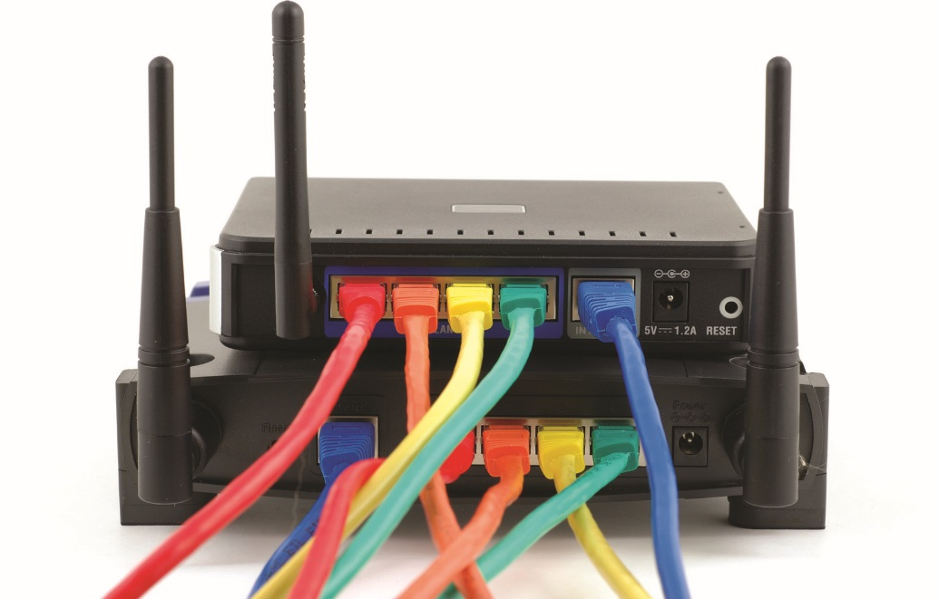
IT Essentials (CompTIA A+) Ch. 22
Wireless Networking

Slide 2
Overview
In this chapter, you will learn how to:
Describe wireless networking components
Analyze and explain wireless networking standards
Install and configure wireless networks
Troubleshoot wireless networks
Notes:
2

Slide 3
Wireless Networking Components
Users who want to go wireless have these options today:
Wireless radio wave networks based on IEEE 802.11 (Wi-Fi) and on Bluetooth
Wireless networks using infrared light
Must use the Infrared Data Association (IrDA) protocol
Cell phone companies offering Internet connectivity through cellular phone networks
Notes:
3

Slide 4
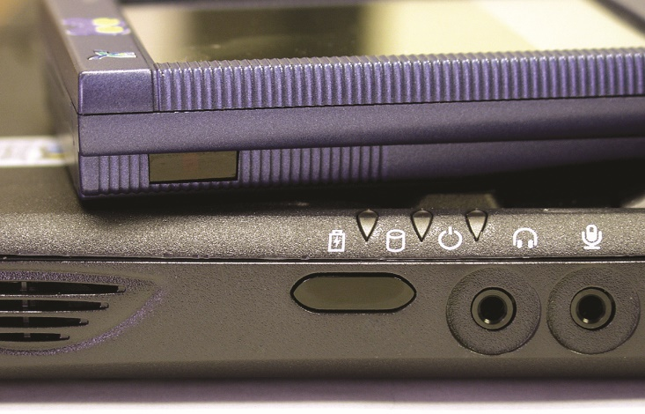
Wireless Networking Components
Wireless capabilities are built into many devices today.
Smartphones and tablets usually come with built-in wireless.
Figure 22.1 Infrared transceiver ports on a laptop and PDA
Notes:
4

Slide 5
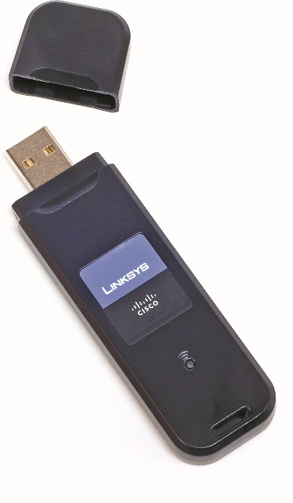
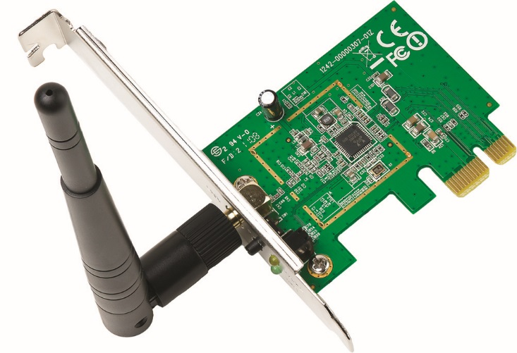
Wireless Networking Components
Wi-Fi and Bluetooth are often integrated or can be added easily.
Figure 22.2 Wireless PCIe add-on card
Figure 22.3 External USB wireless NIC
Notes:
5

Slide 6

Wireless Networking Components
Figure 22.4 Smartphone with wireless capability

Slide 7
Wireless Networking Components
Wireless access point (WAP)
Wireless Ethernet devices can connect to a WAP.
A WAP acts like a hub to the wireless hosts in the area.
More advanced WAPs can use Power over Ethernet (PoE).
Bluetooth
Built-in option on many newer PCs and peripheral devices
Add to older PCs with external USB Bluetooth adapter
Notes:
7
Wireless access points are commonly known as WAPs, APs, or access points.

Slide 8
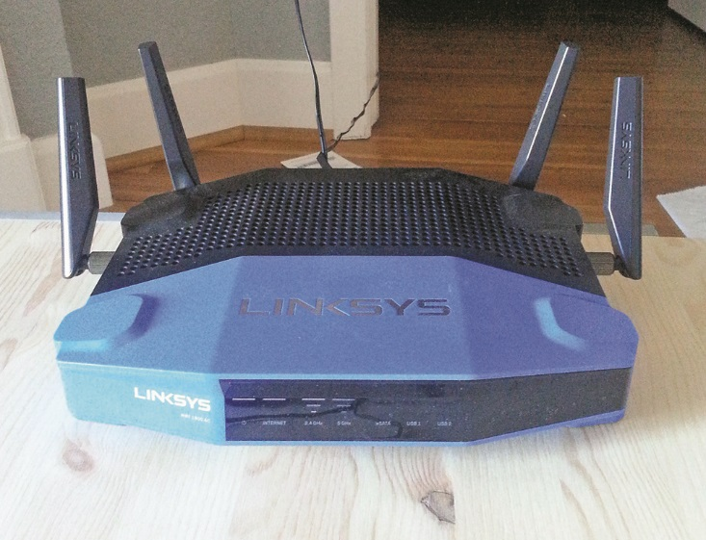
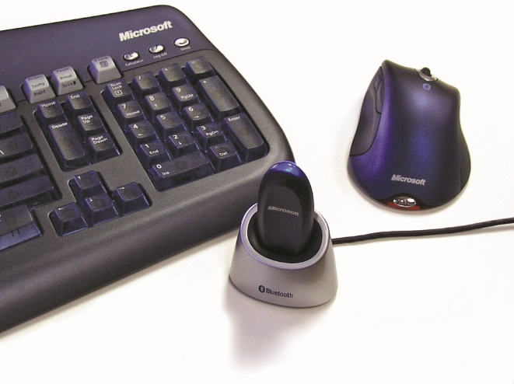
Wireless Networking Components
Figure 22.5 Linksys device that acts as wireless access point, switch, and router
Figure 22.6 External USB Bluetooth adapter, keyboard, and mouse

Slide 9
Wireless Networking Software
Wireless devices use the same networking clients and protocols as wired networks.
Use carrier sense multiple access/collision avoidance (CSMA/CA) networking scheme
Option to use Request to Send/Clear to Send (RTS/CTS)
Transmitting node issues an RTS to the receiving node as a request; receiving node replies with a CTS.
Once the data is received, the receiving node sends an ACK (acknowledgment).
Avoids collisions, but adds significant overhead to the process and can impede performance.
Notes:
9

Slide 10
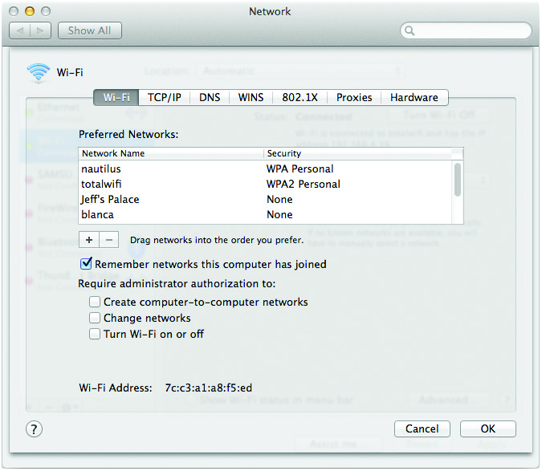
Wireless Networking Software
Wireless adapters are plug and play.
Use Windows built-in utility or vendor-provided utility to configure parameters like network name and set other options.
Figure 22.7 Wireless configuration utility
Notes:
10

Slide 11
Wireless Network Modes
Ad-hoc mode (or peer-to-peer mode)
Each wireless node is in direct contact with every other node in a decentralized free-for-all.
Two or more wireless nodes communicating in ad hoc mode form an Independent Basic Service Set (IBSS).
Ad hoc mode networks are good for:
Small groups of computers
Temporary networks such as a study groups or business meetings
Notes:
11

Slide 12
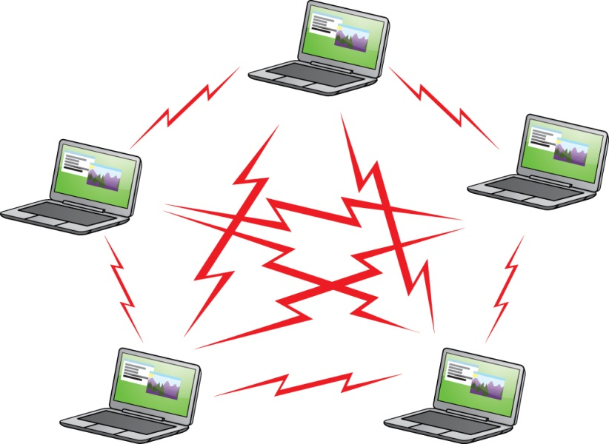
Wireless Network Modes
Figure 22.8 Wireless ad hoc mode network

Slide 13
Wireless Network Modes
Infrastructure mode
This mode uses one or more WAPs to connect wireless nodes to a wired network segment.
A single WAP servicing an area is called a Basic Service Set (BSS).
Adding more WAPs creates an Extended Basic Service Set (EBSS).
Infrastructure mode is suited to networks that need to share dedicated resources such as Internet connections and centralized databases.
Notes:
13

Slide 14
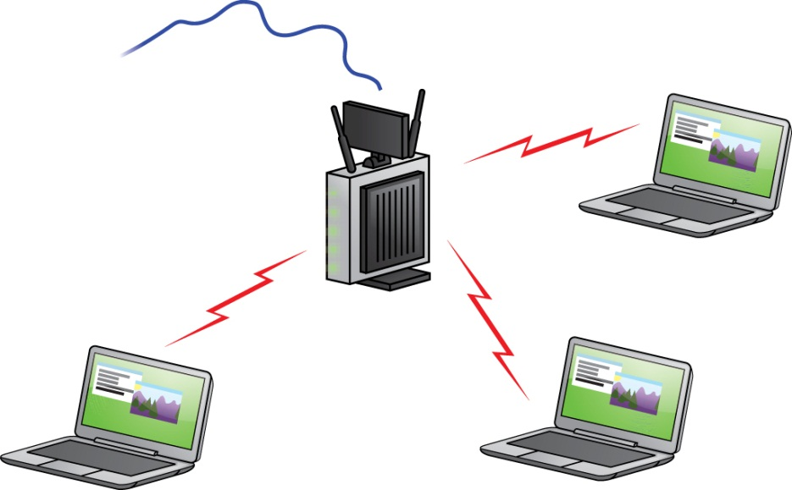
Wireless Network Modes
Figure 22.9 Wireless infrastructure mode network

Slide 15
Wireless Networking Security
Three methods used to secure access to the network:
MAC address filtering
Authentication
Data encryption
Notes:
15

Slide 16
Wireless Networking Security
Service set identifier (SSID) parameter
Configuring a unique SSID (or network name) and password is one security measure.
Older default names and passwords are widely known and available online.
Each wireless network node and access point needs to have the same unique SSID.
Turning off SSID broadcasting makes it harder for unauthorized people to determine your SSID.
Notes:
16
CompTIA lists changing the default SSID and disabling SSID broadcast on the WAP as steps for securing a new wireless network. These practices for managing your SSID don’t secure your network, but they can keep you from catching the attention of someone targeting known vulnerabilities with specific hardware and default settings.

Slide 17
Wireless Networking Security
Access point placement
Limit risk by hiding the network from outsiders.
Keep omni-directional antenna close to center of home or office.
Radio power adjustment
Decrease power until you get reception inside but not outside the target network space.

Slide 18
Wireless Networking Security
MAC address filtering
Filters based on each host’s unique MAC address
Creates a type of accepted user list
Wired Equivalent Privacy (WEP)
Encrypts data using 40-bit or 104-bit encryption
Includes a flaw that makes it extremely vulnerable to attack
Notes:
18

Slide 19
Wireless Networking Security
Wi-Fi Protected Access (WPA)
Acts as an interim security upgrade to WEP
Uses the Temporal Key Integrity Protocol (TKIP)
Provides a new encryption key for every sent packet
Protects WPA from many of the attacks that make WEP vulnerable
Deprecated due to flaws of its own
Uses encryption key integrity-checking through Extensible Authentication Protocol (EAP)
Notes:
19

Slide 20
Wireless Networking Security
Wi-Fi Protected Access 2 (WPA2)
Based on the IEEE 802.11i standard
Locks down wireless networks
Uses Advanced Encryption Standard (AES)
Upgrade to WPA2, if not already using it
Notes:
20

Slide 21
Wireless Networking Security
Wi-Fi Protected Setup (WPS)
Created to make it easier for users to configure secure connections
Works either by pushing a button or by entering an eight-digit code
Cracked easily by hackers
Shut down WPS to prevent

Slide 22
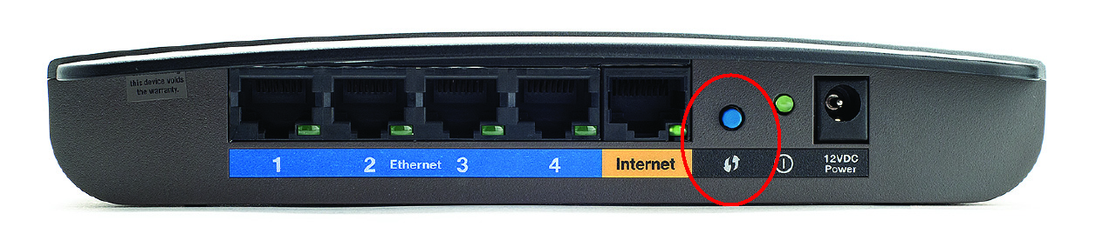
Wireless Networking Security
Figure 22.10 WPS button on an e2500 Router

Slide 23
Speed and Range Issues
Wireless speeds range from 2 Mbps to 1+ Gbps.
Speed is affected by distance between wireless nodes.
Speed is dynamically negotiated.
Maximum throughput occurs at close range.
Within about 25 feet
At edge of range, throughput may fall to 1 Mbps.
Dead spots and interfering devices can affect signal.
Notes:
23
Checking Signal Strength You can see the speed and signal strength on your wireless network by looking at the wireless NIC’s status. In Windows, open the Network and Sharing Center, select Change adapter settings (Manage network connections in Vista), then double-click your wireless NIC to view the status dialog box.

Slide 24
Speed and Range Issues
Ways to increase range
Install multiple WAPs to permit “roaming” between one WAP’s coverage area and another’s—an EBSS.
Install a replacement that increases a single WAP’s signal strength, thus increasing its range.
Signal boosters can give you even more power.
Wireless repeaters/extenders can receive and rebroadcast a Wi-Fi signal.
Notes:
24

Slide 25
Wireless Networking Standards
Today’s wireless world is dominated by radio frequency (RF) technologies:
802.11 (Wi-Fi)
Infrared
Bluetooth
Cellular

Slide 26
IEEE 802.11-Based Wireless Networking
802.11 wireless Ethernet standard (Wi-Fi)
Defines methods devices may use to communicate via spread-spectrum radio waves
Broadcasts in small, discrete chunks over available frequencies within certain range
Uses one of two radio bands: 2.4 GHz and 5 GHz
Extended to 802.11a, 802.11b, 802.11g, 802.11n, and 802.11ac variations
Newer wireless devices provide backward compatibility with older wireless devices
Notes:
26
Note: Wi-Fi is by far the most widely adopted wireless networking type today. Not only do millions of private businesses and homes have wireless networks, but many public places such as coffee shops and libraries also offer Internet access through wireless networks.

Slide 27
IEEE 802.11-Based Wireless Networking
802.11a
802.11 standard on the market after 802.11b
Operates in the 5-GHz frequency range
Devices using 802.11a less prone to interference
Throughput greater than 802.11 and 802.11b
802.11b
The first standard to be widely adopted
Actual throughput of 4 to 6 Mbps on average
Maximum range of 300 ft under ideal conditions
Subject to interference from other devices

Slide 28
IEEE 802.11-Based Wireless Networking
802.11g
Introduced in 2003
Offers transfer speeds of 802.11a with the wider range of 802.11b
Runs in 2.4-GHz ISM band
Notes:
Because cellular telephones typically support both cellular networks and 802.11x Wi-Fi networks, many can be used to bridge the gap. Using internal utilities or apps, you can set up your phone as a Wi-Fi WAP that can pass signals to and from the Internet via the cellular connection. Turning your phone into a WAP is known as creating a hotspot; using it to bridge to the cellular network is called tethering.

Slide 29
Wireless Networking Standards
802.11n
Faster speeds
New antenna technology
Multiple in/multiple out (MIMO)
Enables devices to make multiple simultaneous connections
Transmit beamforming
Minimize dead spots with multiple-antenna technology
Dual-band operation support

Slide 30
Wireless Networking Standards
802.11ac
This standard uses only the 5-GHz band.
New version of MIMO called Multiuser MIMO (MU-MIMO) gives WAP ability to transmit to multiple users simultaneously.

Slide 31
Wireless Networking Standards
Table 22.1 | Comparison of 802.11 Standards
Standard | 802.11a | 802.11b | 802.11g | 802.11n | 802.11ac
Max. throughput | 54 Mbps | 11 Mbps | 54 Mbps | 100+ Mbps | 1+ Gbps
Max. range | 150 feet | 300 feet | 300 feet | 300+ feet | 300+ feet
Frequency | 5 GHz | 2.4 GHz | 2.4 GHz | 2.4 GHz and 5 GHz | 5 GHz
Security | SSID, MAC filtering, industry-standard WEP, WPA, WPA2 | SSID, MAC filtering, industry-standard WEP, WPA, WPA2 (later hardware) | SSID, MAC filtering, industry-standard WEP, WPA, WPA2 | SSID, MAC filtering, industry-standard WEP, WPA, WPA2 | SSID, MAC filtering, industry-standard WEP, WPA, WPA2
Compatibility | 802.11a | 802.11b | 802.11b, 802.11g | 802.11b, 802.11g, 802.11n, (802.11a in some cases) | 802.11a, 802.11b, 802.11g, 802.11n
Notes:
31
Note: Devices that use the original 802.11 (with no letter) standard are obsolete these days.

Slide 32
Wireless Networking Standards
Table 22.1 | Comparison of 802.11 Standards
Standard | 802.11a | 802.11b | 802.11g | 802.11n | 802.11ac
Communi-cation mode | Ad hoc or infrastructure | Ad hoc or infrastructure | Ad hoc or infrastructure | Ad hoc or infrastructure | Ad hoc or infrastructure
Description | Eight available channels. Less prone to interference than 802.11b and 802.11g. | Fourteen channels available in the 2.4-GHz band (only eleven of which can be used in the U.S. due to FCC regulations). Three non-overlapping channels. | Improved security enhancements. Fourteen channels available in the 2.4-GHz band (only eleven of which can be used in the U.S. due to FCC regulations). Three non-overlapping channels. | Same as 802.11g but adds the 5-GHz band that 802.11a uses. 802.11n can also make use of multiple antennas (MIMO) to increase its range and speed. | Expands on 802.11n by adding streams, bandwidth, and higher speed in the 5-GHz band. Uses MU-MIMO and beamforming antenna technology to optimize wireless connections.
Notes:
32

Slide 33
Try This! 802.11ac Products
Visit a big box electronics retail store, like Microcenter, Fry’s, Best Buy, or Newegg (online)
What variations of 802.11ac products do you see?
Note the letters and numbers associated with the products.
Compare 802.11ac routers and WAPs.
What are the differences in radio frequencies, number of antennas used, number of radios employed within the device, speed, and throughput?
How do prices compare?

Slide 34
Other Wireless Standards
Infrared wireless networking
Functions in ad hoc mode
Uses the Infrared Data Association (IrDA) protocol
Requires line-of-sight with maximum 1 m distance
No authentication or encryption
Operates at half-duplex
Notes:
34
Note: While Wi-Fi dominates the wireless networking market, it isn’t the only standard. A lot of smaller networks (we’re talking two-computers small) use infrared or Bluetooth to connect devices. Mobile devices, such as smartphones and some tablets, connect wirelessly via cellular networks.

Slide 35
Other Wireless Standards
Bluetooth
Designed to create small wireless networks—personal area networks (PANs)—for specific jobs
Connecting input devices such as keyboards and mice
Upgraded over the years to make it faster and more secure
Employs classes that define maximum power usage and maximum distance
Class 1: 100mW and 100 meters
Class 2: 2.5 mW and 2 meters
Class 3: 1mW and 1 meter
Notes:
35
10 meters = ~30 feet
mW = milliwatts
Note: The Bluetooth 3.0 and 4.0 standards were released several years ago, but neither has seen the same level of adoption as earlier standards.

Slide 36
Other Wireless Standards
Cellular wireless network
Enables you to connect to the Internet through a network-aware smartphone, tablet, or other mobile device
Covered in chapter 23
Notes:
36

Slide 37
Installing and Configuring Wireless Networking
Physically installing a wireless network adapter is the same as installing a wired NIC.
Install the device and let plug and play handle the rest.
Install device’s supplied driver.
Notes:
37
Windows XP, Vista, and 7 include wireless configuration utilities.

Slide 38
Installing and Configuring Wireless Networking
Wi-Fi configuration
Ad hoc mode
WAP is not needed.
No two nodes use the same IP address.
Ensure File and Printer Sharing service is running.
Infrastructure mode
This mode typically employs one or more WAPs connected to a wired network segment.
All nodes and WAPs need to be configured with the same SSID.

Slide 39
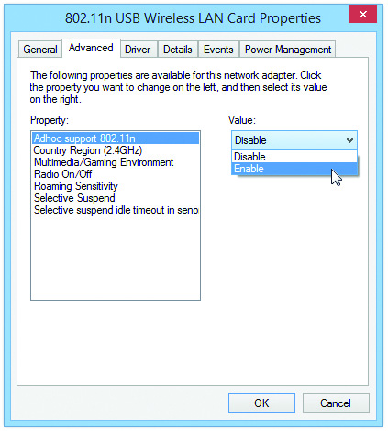
Installing and Configuring Wireless Networking
Figure 22.11 Selecting ad hoc mode in a wireless configuration utility

Slide 40
Wi-Fi Configuration
WAPs configured through browser-based setup utility
Enter the WAP’s default IP address (see documentation or try 192.168.1.1) in your browser.
Enter the default administrative password (in documentation) to log in.
Notes:
40

Slide 41
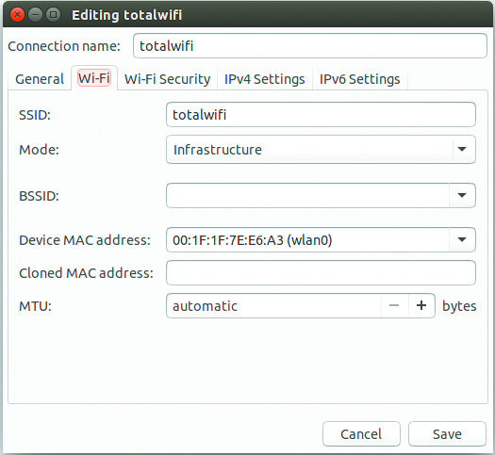
Installing and Configuring Wireless Networking
Figure 22.12 Infrastructure mode is set in a wireless configuration utility.

Slide 42
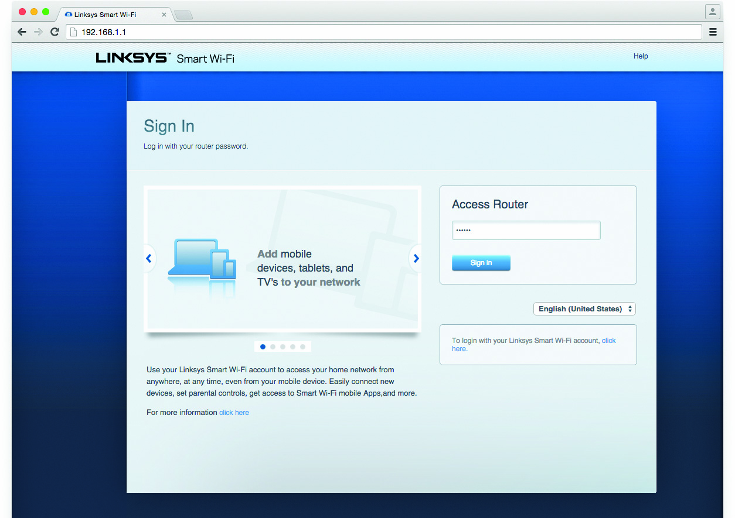
Installing and Configuring Wireless Networking
Figure 22.13 Security login for Linksys WAP

Slide 43
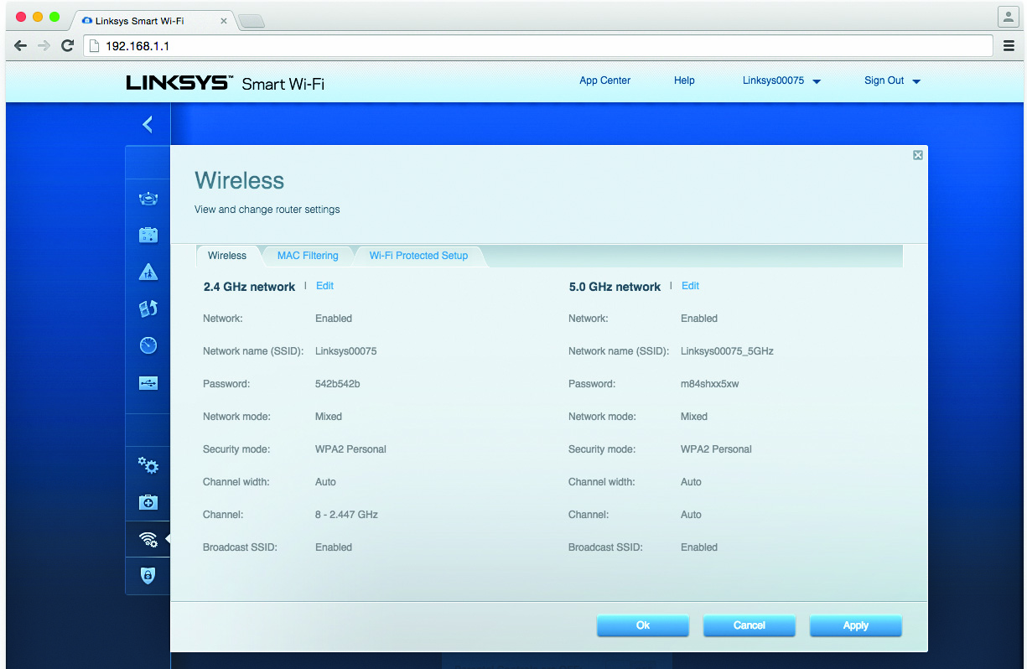
Installing and Configuring Wireless Networking
Figure 22.14 Linksys WAP setup screen

Slide 44
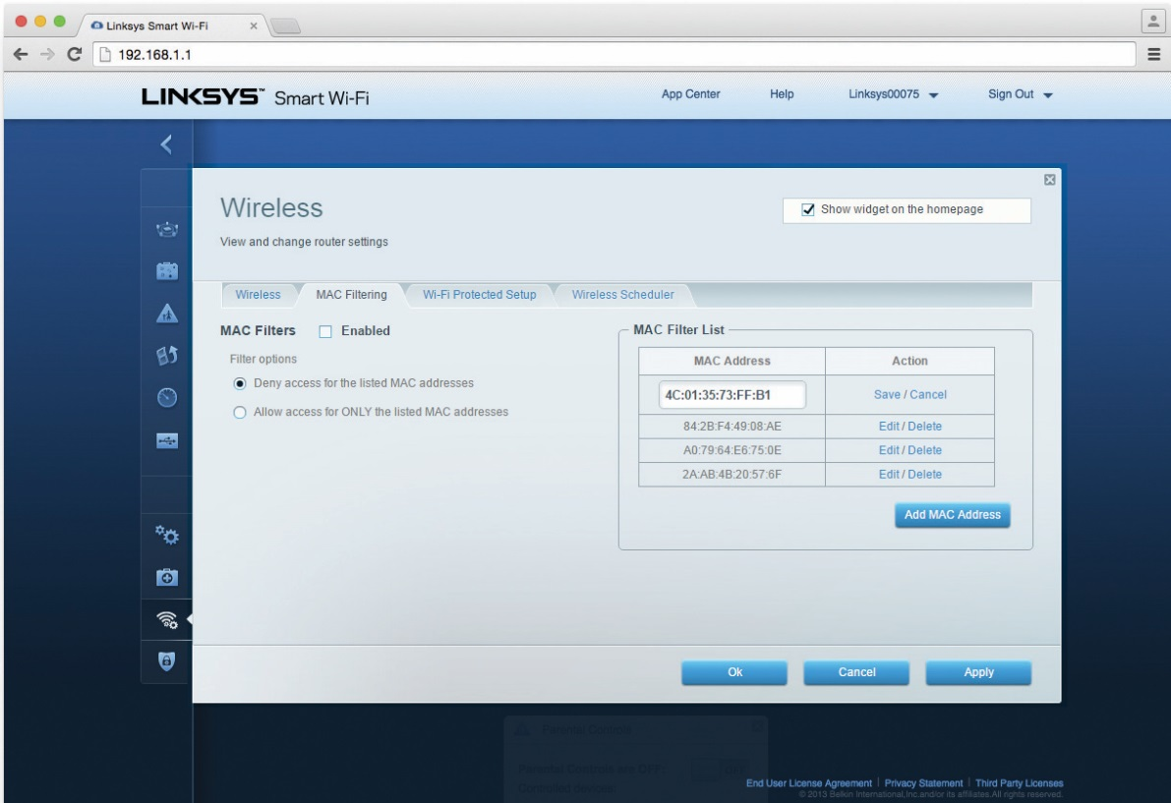
Installing and Configuring Wireless Networking
Figure 22.15 MAC filtering configuration screen for a Linksys WAP

Slide 45
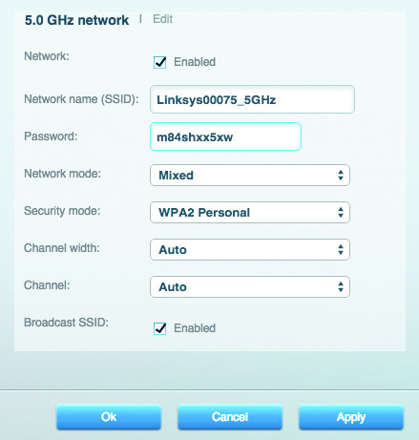
Installing and Configuring Wireless Networking
Figure 22.16 Basic properties panel for a Linksys WAP

Slide 46
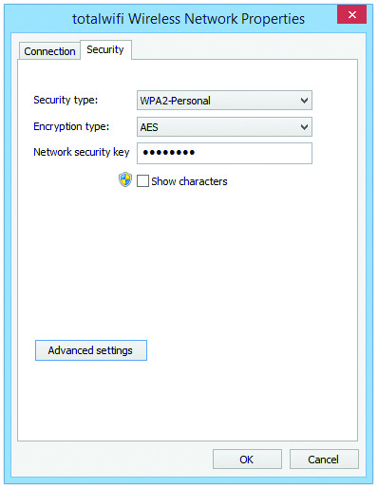
Installing and Configuring Wireless Networking
Figure 22.17 Encryption screen on client wireless network adapter configuration utility

Slide 47
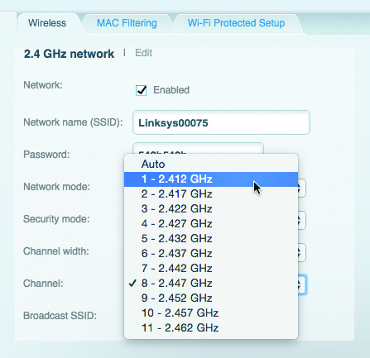
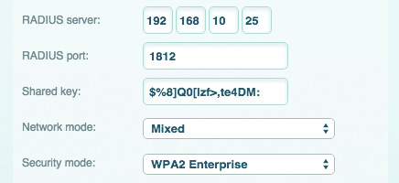
Installing and Configuring Wireless Networking
Figure 22.18 Encryption screen with RADIUS option
Figure 22.19 Changing the channel

Slide 48
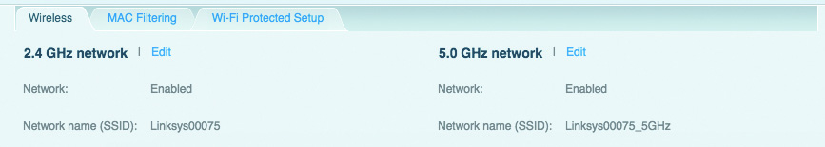
Installing and Configuring Wireless Networking
Figure 22.20 Linksys router sporting dual bands

Slide 49
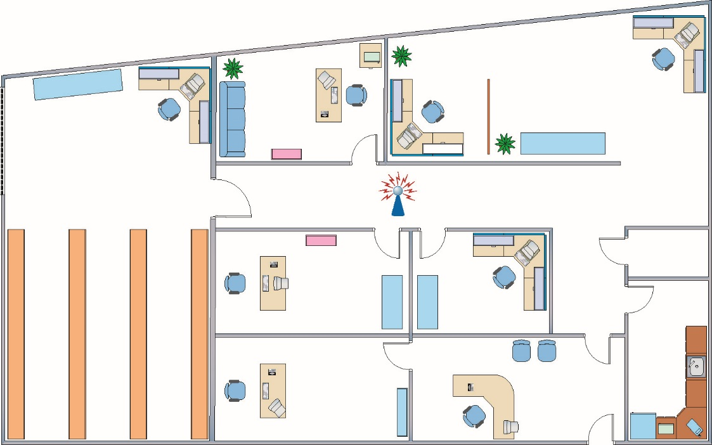
Placing the Access Point(s)
Optimal location depends on the area you want to cover.
Omni-directional and centered
Figure 22.21 Room layout with WAP in the center
Notes:
If you want to know whether your local café, bookstore, airport, or other public place has a Wi-Fi access point (a hotspot), you can use a Wi-Fi or wireless locator. The locator is usually the size of your car remote and lights up or otherwise signals you whenever you are in range of a Wi-Fi access point. Wi-Fi locators, also called Wi-Fi analyzers, can also be installed as an app on a Wi-Fi smartphone.

Slide 50
Antennas
A typical WAP uses an straight wire antenna called a dipole antenna.
Omnidirectional
An antenna strengthens and focuses the radio frequency (RF) output from a WAP.
Better antennas can improve gain.
Gain is measured in decibels (dB).
Replace the factory antennas with one or more bigger antennas.

Slide 51
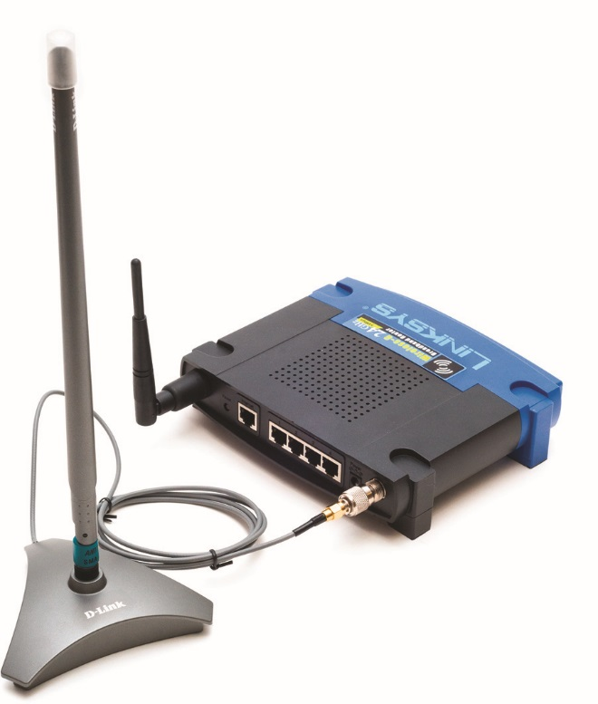
Antennas
Figure 22.22 WAP with replacement antenna

Slide 52
Antennas
Yagi antennas
Increase gain in a specific direction
Reduce gain in all other directions
Polarization
Polarization is an electromagnetic property of antennas and their transmitted signals.
Signal has the same alignment as the antenna.
For best connection between a client and a WAP, wireless signals should have the same polarization.
Notes:
To achieve a good compromise in supporting connections to clients with different antenna polarization, orient the WAP antennas on a 45-degree angle.

Slide 53
Bluetooth Configuration
Need two Bluetooth devices
Enable Bluetooth
Place both devices in pairing mode.
Some devices continuously listen for a pairing request.
Other devices must be set to pairing (discovery) mode.
Upon discovering each other:
Devices agree on compatible Bluetooth version, speed, and set of features.
Final step (security component) is to confirm intent to pair devices, e.g., short code entries
Make sure everything work; repair if needed.

Slide 54
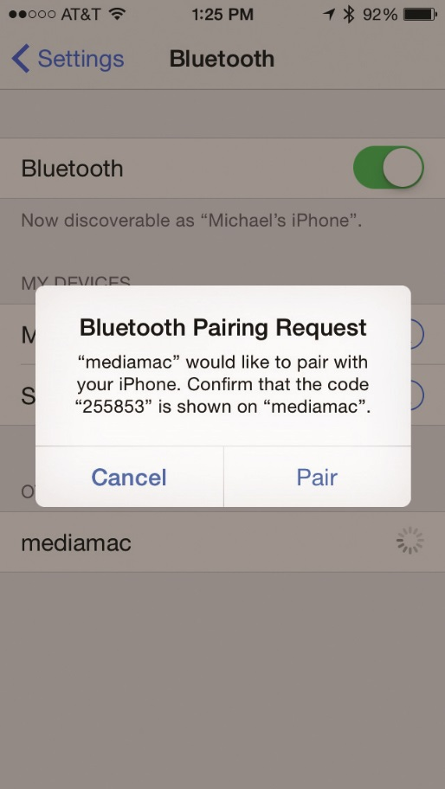
Bluetooth Configuration
Figure 22.23 iPhone receiving a pairing request from “mediamac”

Slide 55
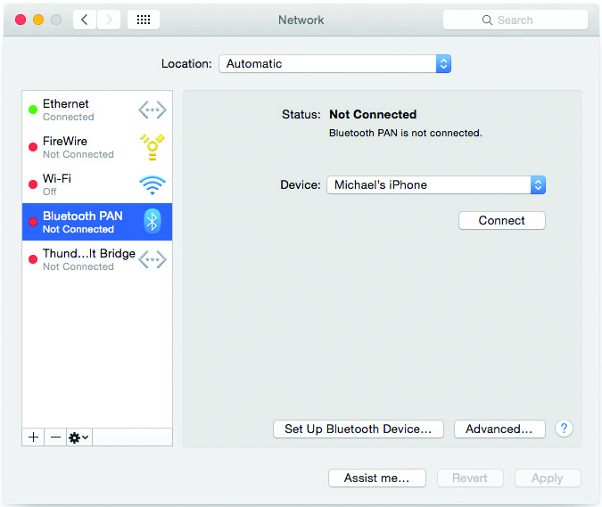
Bluetooth Configuration
Figure 22.24 Mac OS X Bluetooth PAN ready to connect using “Michael’s iPhone”

Slide 56
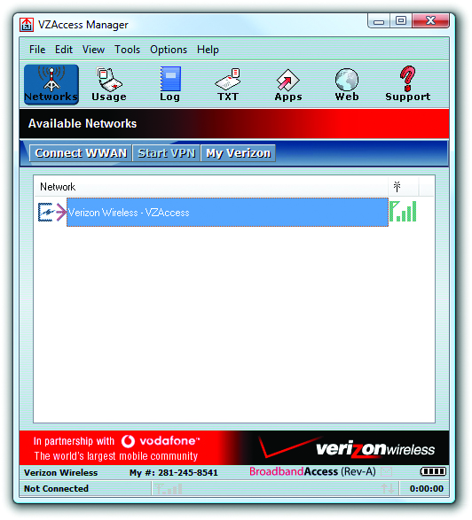
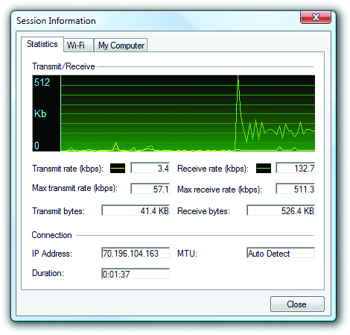
Cellular Configuration
No single standard or method
Cards and software change based on vendor.
Plug in the card and install the software.
Figure 22.25 VZAccess Manager
Figure 22.26 Session statistics for VZAccess Manager
Notes:
Upon card insertion, the setup program automatically launches. These cards almost always have all the required software and drivers built into the cards themselves, so there are no optical discs to worry about. Once you’ve installed the necessary software, launch the connection application.

Slide 57
Troubleshooting Wi-Fi
Who is affected by the problem?
Asking this question helps localize the issue.
What is the nature of the network problem?
Zeroing in on a particular service or application helps define the problem.
When did the problem start?
Did some single action cause the problem?
Were there outside influences that caused the problem?

Slide 58
Hardware Troubleshooting
Open Windows device manager and look for error or conflict with wireless adapter.
Exclamation point indicates driver error.
Downward facing arrow means it has been disabled.
Enable or reinstall as needed.
If device is not listed at all, remove and reinstall the device.
Notes:
As with all things computing, don’t forget to do the standard PC troubleshooting thing and reboot the computer before you make any configuration or hardware changes!

Slide 59
Software Troubleshooting
Wireless adapter configuration utility
Install vendor-provided drivers and configuration utility properly.
If necessary, uninstall the device in Device Manager and start again from scratch.
WAP’s firmware version
Visit the manufacturer’s Web site to find updates.
Follow the manufacturer’s updating instructions.
Notes:
When updating the firmware of any device, including your WAP, there’s always a chance something could go wrong and render it unusable--and you may hear techs say such a device has been “bricked.” Why? It’s no more useful than a brick!

Slide 60
Connectivity Troubleshooting
Typical problem sources
Incorrect configuration (such as password)
Low signal strength
Bar graph typically shows signal strength.
Link lights on the wireless NIC
Check link lights to determine whether data packets passing to and from the network.
NIC’s configuration utility
Check link state for connection status: connected or disconnected.

Slide 61
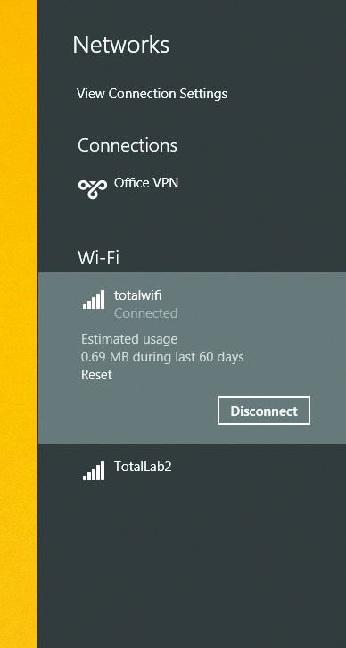
Connectivity Troubleshooting
Figure 22.27 Windows 8.1 Pro’s wireless configuration utility

Slide 62
Connectivity Troubleshooting
Potential solutions
Adjust antenna
Relocate WAP
Relocate PC
Change the channel your network uses
Change the channel an interfering device uses
Move or replace a device causing interference

Slide 63
Configuration Troubleshooting
Most common type of problem is misconfigured hardware or software.
Verify SSID configuration for any bands in use.
Check access point and affected wireless nodes.
Be careful not to add blank characters where they don’t belong.
If a client can no longer connect:
WAP may be down or may have been changed.
Ensure MAC address of client is on the list of accepted users.

Slide 64
Configuration Troubleshooting
Check security configuration.
Make sure all wireless nodes and access points match.
Enter the correct encryption key.
Match the encryption level on all access points and wireless nodes.

Slide 65


Slide 66
Summary
Describe wireless networking components
Analyze and explain wireless networking standards
Install and configure wireless networks
Troubleshoot wireless networks

Slide 67


